Slide 1
Java Collection
Raghu G B
Notes:
This template can be used as a starter file for presenting training materials in a group setting.
Sections
Right-click on a slide to add sections. Sections can help to organize your slides or facilitate collaboration between multiple authors.
Notes
Use the Notes section for delivery notes or to provide additional details for the audience. View these notes in Presentation View during your presentation.
Keep in mind the font size (important for accessibility, visibility, videotaping, and online production)
Coordinated colors
Pay particular attention to the graphs, charts, and text boxes.
Consider that attendees will print in black and white or grayscale. Run a test print to make sure your colors work when printed in pure black and white and grayscale.
Graphics, tables, and graphs
Keep it simple: If possible, use consistent, non-distracting styles and colors.
Label all graphs and tables.

Slide 2
Collection in java
Collections in java is a framework that provides an architecture to store and manipulate the group of objects.
All the operations that you perform on a data such as
Searching
Sorting
Manipulation
Insertion
Deletion
Cont……
Notes:
Give a brief overview of the presentation. Describe the major focus of the presentation and why it is important.
Introduce each of the major topics.
To provide a road map for the audience, you can repeat this Overview slide throughout the presentation, highlighting the particular topic you will discuss next.

Slide 3
Collection in java
Java collection is simple mean collection of Objects.
Java collection provide many Interfaces such as
List
Queue
Dqueue
Set
SortedSet
Notes:
Give a brief overview of the presentation. Describe the major focus of the presentation and why it is important.
Introduce each of the major topics.
To provide a road map for the audience, you can repeat this Overview slide throughout the presentation, highlighting the particular topic you will discuss next.

Slide 4
Collection in java
Java collection provide many Abstract Classes such as
Abstract Collection
Abstract List
Abstract Sequential List
Abstract Set
Notes:
Give a brief overview of the presentation. Describe the major focus of the presentation and why it is important.
Introduce each of the major topics.
To provide a road map for the audience, you can repeat this Overview slide throughout the presentation, highlighting the particular topic you will discuss next.

Slide 5
Collection in java
Java collection provide many Concrete Classes such as
ArrayList
LinkedList
Vector
Stack
PriorityQueue
ArrayDqueue
Hashset
LinkedHashset
Treeset
Notes:
Give a brief overview of the presentation. Describe the major focus of the presentation and why it is important.
Introduce each of the major topics.
To provide a road map for the audience, you can repeat this Overview slide throughout the presentation, highlighting the particular topic you will discuss next.

Slide 6
Hierarchy of Collection Framework
<<Collection>>
<<Queue>>
<Abstract Collection>
<<List>>
<<Set>>
<Abstract List>
<Abstract Set>
<ArrayList>
<PriorityQueue>
<AbstractSequentialListList>
<<Dqueue>>
<<SortedSet>>
<HashSet>
<LinkedList>
<TreeSet>
<ArrayDqueue>
<LinkedHashSet>
<Vector>
The java.util package contains all the classes and interfaces for Collection framework.
Notes:
This is another option for an Overview slides using transitions.

Slide 7
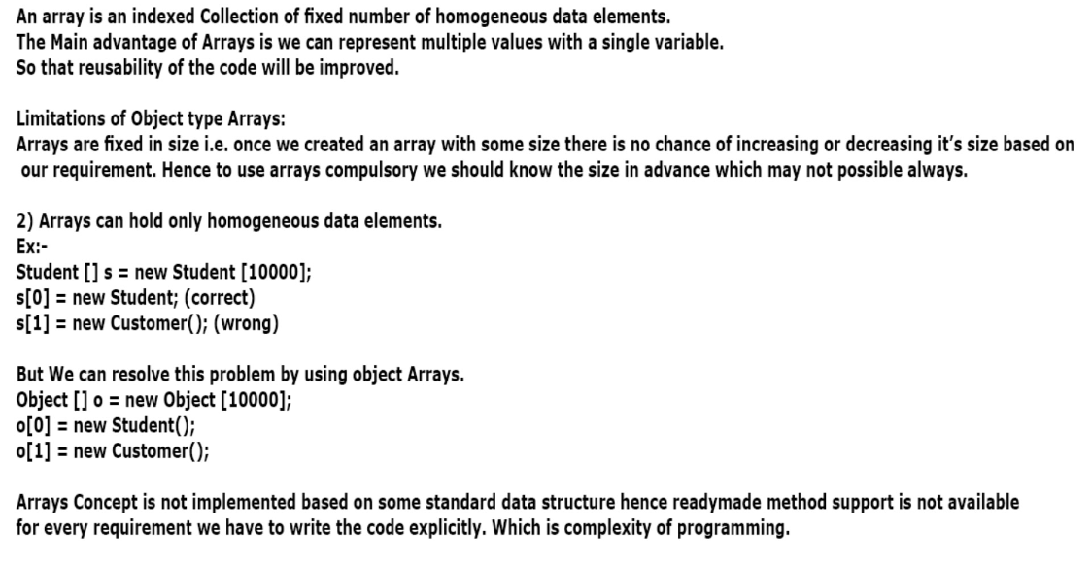
Need of Collection in java
Notes:
Give a brief overview of the presentation. Describe the major focus of the presentation and why it is important.
Introduce each of the major topics.
To provide a road map for the audience, you can repeat this Overview slide throughout the presentation, highlighting the particular topic you will discuss next.

Slide 8
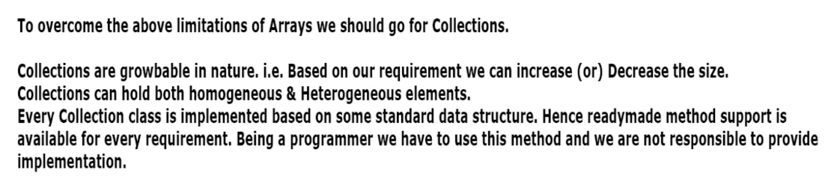
Need of Collection in java
Notes:
Give a brief overview of the presentation. Describe the major focus of the presentation and why it is important.
Introduce each of the major topics.
To provide a road map for the audience, you can repeat this Overview slide throughout the presentation, highlighting the particular topic you will discuss next.

Slide 9
Difference between Collection And Collections
Collection: Collection is an Interface which can be used to represent a group of individual objects as a single Entity
Collections: Collections is an utility class present in java.util package to define several utility methods (like Sorting , searching…)for collection Objects.
Notes:
Give a brief overview of the presentation. Describe the major focus of the presentation and why it is important.
Introduce each of the major topics.
To provide a road map for the audience, you can repeat this Overview slide throughout the presentation, highlighting the particular topic you will discuss next.

Slide 10

1.Collection
If you want to represent group of individual object as a single entity then we
should go for a collection .
Collection interface defines the most common methods which are applicable
for any collection objects
In general collection interface is considered as root interface of Collection interface
There is concrete class which implements collection interface directly
Notes:
This is another option for an Overview slides using transitions.

Slide 11
Methods of Collection interface
1 public boolean add(Object element)
is used to insert an element in this
collection.
2 public boolean addAll(collection c)
is used to insert the specified
collection elements in the invoking
collection.
Notes:
Give a brief overview of the presentation. Describe the major focus of the presentation and why it is important.
Introduce each of the major topics.
To provide a road map for the audience, you can repeat this Overview slide throughout the presentation, highlighting the particular topic you will discuss next.

Slide 12
Methods of Collection interface
3 public boolean remove(Object element)
is used to delete an element from
this collection.
4 public boolean removeAll(Collection c)
is used to delete all the elements of
specified collection from the
invoking collection.
Notes:
Give a brief overview of the presentation. Describe the major focus of the presentation and why it is important.
Introduce each of the major topics.
To provide a road map for the audience, you can repeat this Overview slide throughout the presentation, highlighting the particular topic you will discuss next.

Slide 13
Methods of Collection interface
5 public boolean retainAll(Collection c)
is used to delete all the elements of
invoking collection except the specified collection.
6 public int size()
return the total number of elements
in the collection.
7 public void clear()
removes the total no of element
from the collection.
Notes:
Give a brief overview of the presentation. Describe the major focus of the presentation and why it is important.
Introduce each of the major topics.
To provide a road map for the audience, you can repeat this Overview slide throughout the presentation, highlighting the particular topic you will discuss next.

Slide 14
Methods of Collection interface
8 public boolean contains(object element)
is used to search an element.
9 public boolean containsAll(Collection c)
is used to search the specified collection in this collection.
10 public Iterator iterator()
returns an iterator.
11 public Object[] toArray()
converts collection into array.
Notes:
Give a brief overview of the presentation. Describe the major focus of the presentation and why it is important.
Introduce each of the major topics.
To provide a road map for the audience, you can repeat this Overview slide throughout the presentation, highlighting the particular topic you will discuss next.

Slide 15
Methods of Collection interface
12 public boolean isEmpty()
checks if collection is empty.
13 public boolean equals(Object element)
matches two collection.
14 public int hashCode()
returns the hashcode number for collection.
Notes:
Give a brief overview of the presentation. Describe the major focus of the presentation and why it is important.
Introduce each of the major topics.
To provide a road map for the audience, you can repeat this Overview slide throughout the presentation, highlighting the particular topic you will discuss next.

Slide 16
Iterator interface
Iterator interface provides the facility of iterating the elements in forward direction only.
Notes:
Give a brief overview of the presentation. Describe the major focus of the presentation and why it is important.
Introduce each of the major topics.
To provide a road map for the audience, you can repeat this Overview slide throughout the presentation, highlighting the particular topic you will discuss next.

Slide 17
Methods of Iterator interface
There are only three methods in the Iterator interface. They are:
1. public boolean hasNext()
it returns true if iterator has more elements.
2. public object next()
it returns the element and moves the cursor pointer to the next element.
3. public void remove()
it removes the last elements returned by the iterator. It is rarely used.
Notes:
Give a brief overview of the presentation. Describe the major focus of the presentation and why it is important.
Introduce each of the major topics.
To provide a road map for the audience, you can repeat this Overview slide throughout the presentation, highlighting the particular topic you will discuss next.

Slide 18
2.List
List is a child interface of Collection
If you want to represent group of individual object as a single entity where duplicates are allowed and insertion ordered preserved then we should go for List .
We can differentiates the duplicates using index
We can preserve insertion order by using index .hence index play important Role in List interface

Slide 19
List Specific methods
Void add(int index , Object obj);
boolean addAll(int index Collection c);
Object get(int index);
Object remove(int index);
Object set(int index, Object new);
Int indexOf(Object obj);
Int lastIndexof(Object obj);
ListIterator listIterator();

Slide 20
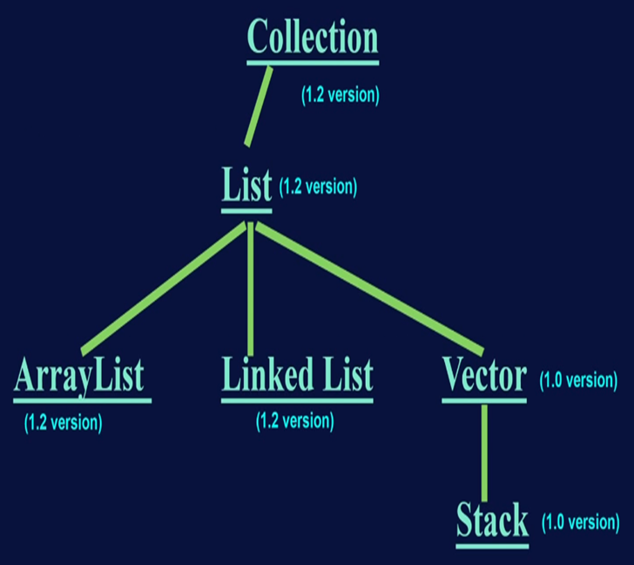


Slide 21


ArrayList

Slide 22
Array List
The underlined data structure is resizable array and grow able array.
Duplicates are allowed.
Insertion order is preserved
Heterogeneous elements are allowed[except tree set and tree map every where heterogeneous elements are allowed]
Null insertion is possible.
Notes:
This is another option for an Overview slide.

Slide 23
Constructor in ArrayList
1. ArrayList al= new ArrayList();
Creates an empty arraylist object with default initial capacity 10.
Once its reaches its map capacity new arraylist will be created with the new Capacity.
New capacity=(cc*3/2)+1.
2. ArrayList al=new ArrayList( int initialCapacity );
3. ArrayList al= new ArrayList (Collection c);
Notes:
What will the audience be able to do after this training is complete? Briefly describe each objective how the audience will benefit from this presentation.

Slide 24
Usually we can use collection objects to hold and transfer the objects from one place to another place To provide support for this requirement every collection already implements Serializable and Clonable interface
Notes:
Use a section header for each of the topics, so there is a clear transition to the audience.

Slide 25
ArrayList and Vector classes implements RandomAcess interface so that we can access any random element with the same speed.
Hence if your frequent operation is retrieval
Operation then we go for ArrayList
RandomAcess interface present in java.util package and it is a Marker Interface.
Notes:
Use a section header for each of the topics, so there is a clear transition to the audience.

Slide 26
ArrayList is the best choice for frequent retrieval operation because its implements
RandomAcess interface
ArrayList is worst choice if frequent insertion or deletion operations because lot of shifting is needed .
Notes:
Use a section header for each of the topics, so there is a clear transition to the audience.

Slide 27
LinkedList

Slide 28
Linked List
The underlined data structure is Doubly Linked List.
Duplicates are allowed.
Insertion order is preserved
Heterogeneous elements are allowed
Null insertion is possible.
Linked List is implements Serializable and Clonable interface but not RandomAcess interface
Notes:
This is another option for an Overview slide.

Slide 29
LinkedList is the best choice if our frequent operation is insertion or deletion in the middle
LinkedList is the worst choice if our frequent operation is retrieval operation
Notes:
Use a section header for each of the topics, so there is a clear transition to the audience.

Slide 30
LinkedList Specific methods
Usually we use LinkedList to implements the stack and queues to provide support for this requirements LinkedList class defines the Fallowing methods
Void addFirst(Object obj);
Void addLast(Object obj);
Object getFirst();
Object getLast();
Object removeFirst();
Object removeLast();
Notes:
This is another option for an Overview slide.

Slide 31
Constructor in LinkedList
1. LinkedList al= new LinkedList();
Creates an empty LinkedList object
Here no capacity
2. LinkedList al= new LinkedList (Collection c);
creates equivalent LinkedList object for passed Collection.
Notes:
What will the audience be able to do after this training is complete? Briefly describe each objective how the audience will benefit from this presentation.

Slide 32
ListIterator interface
Iterator interface provides the facility of iterating the elements in forward and backward direction also.
Hence ListIterator is Bidirectional Cursor
By using ListIterator we can perform replacement and addition of new objects
in addition to read and remove operations
Notes:
Give a brief overview of the presentation. Describe the major focus of the presentation and why it is important.
Introduce each of the major topics.
To provide a road map for the audience, you can repeat this Overview slide throughout the presentation, highlighting the particular topic you will discuss next.

Slide 33
We can create a ListIterator object using listiterator() method.
this method present in List interface.
public ListIterator listiterator();
Example :
ListIterator li=l. listiterator ();
l is the list type object.
Notes:
Give a brief overview of the presentation. Describe the major focus of the presentation and why it is important.
Introduce each of the major topics.
To provide a road map for the audience, you can repeat this Overview slide throughout the presentation, highlighting the particular topic you will discuss next.

Slide 34
ListIterator interface
ListIterator is a child interface of Iterator And hence all the method of Iterator by default available to ListIterator.
ListIterator defines fallowing methods
1.public boolean hasNext();
2.public Object next();
3.public int nextIndex();
4. public boolean hasPrevious();
5. public Object previous();
6. public int previousIndex();
Notes:
Give a brief overview of the presentation. Describe the major focus of the presentation and why it is important.
Introduce each of the major topics.
To provide a road map for the audience, you can repeat this Overview slide throughout the presentation, highlighting the particular topic you will discuss next.

Slide 35
ListIterator interface
7.public void remove();
8.public void set(Object new);
9.public void add(Object new);
Note: ListIterator is most power full cursor
But limitation is there it applicable only for List implemented Objects and it is not a Universal cursor
Notes:
Give a brief overview of the presentation. Describe the major focus of the presentation and why it is important.
Introduce each of the major topics.
To provide a road map for the audience, you can repeat this Overview slide throughout the presentation, highlighting the particular topic you will discuss next.

Slide 36
Vector

Slide 37
Vector
The underlined data structure is resizable array and grow able array.
Duplicates are allowed.
Insertion order is preserved
Heterogeneous elements are allowed
Null insertion is possible.
Vector implemented by RandomAccess Serializable and Clonable interfaces
Most of the methods present in vector class are synchronized hence vector is Thread safe
best choice is frequently retrieval operation.
Notes:
This is another option for an Overview slide.

Slide 38
Vector Specific methods
For Adding Objects.
1. add(Object o) ->From Collection
2. add(int index ,Object o) -> From List
3. addElement(Object o) ->From vector
For removing Objects
1.remove(Object o) ->From Collection
2.removeElement(Object o) ->From vector
3.remove(int index) ->From List
4.clear() -> From collection
5.removeAll() ->From vector
Notes:
This is another option for an Overview slide.

Slide 39
Vector Specific methods
Object get(int index); ->collection
Object elementAt(int index); ->vector
Object firstElement(); ->vector
Object lastElement(); ->vector
Other methods:-
int capacity();
int size();
Enumeration elements();
Notes:
This is another option for an Overview slide.

Slide 40
Constructor in Vector
1. Vector v= new Vector();
Creates an empty Vector object with default initial
capacity 10 once vector reaches its max capacity
new capacity =2*cc.
2. Vector v = new Vector(Collection c);
creates equivalent Vector object for passed Collection.
Notes:
Add slides to each topic section as necessary, including slides with tables, graphs, and images.
See next section for sample table, graph, image, and video layouts.

Slide 41
Constructor in Vector
3. Vector v= new Vector( int initialCapcity);
Creates an empty Vector object with specified
initial capacity.
4. Vector v = new Vector(int initialCapcity ,
int incrementalCapcity); .
Notes:
Add slides to each topic section as necessary, including slides with tables, graphs, and images.
See next section for sample table, graph, image, and video layouts.

Slide 42
Enumeration

Slide 43
Enumeration
It is a interface
Used to iterate the elements from the legacy class
Methods are:
1) hasmoreElements();
2)nextElement();
Create object:
Enumeration e=v.elements();
Notes:
This is another option for an Overview slide.

Slide 44
Stack

Slide 45
Stack
It is a child class of vector.
It specially designed class for Last In First Out order(LIFO).
Notes:
This is another option for an Overview slide.

Slide 46
Constructor in Stack
1. Stack v= new Stack();
Creates an empty Stack Object
Notes:
Add slides to each topic section as necessary, including slides with tables, graphs, and images.
See next section for sample table, graph, image, and video layouts.

Slide 47
Stack Specific methods
1) Object push(Object obj);
for inserting an object to stack
2) Object pop();
to remove and returns top of the stack
3) Object peak();
to returns the top of the stack without removal of object
Notes:
This is another option for an Overview slide.

Slide 48
Stack Specific methods
4) int Search(Object obj);
if the specified object is available it returns its offset from top of the stack
Notes:
This is another option for an Overview slide.

Slide 49
3. Set
it is a child interface of Collection
Where duplicates are not allowed
Insertion order is not preserved
Set it does not contain any new method
Notes:
This is another option for an Overview slide.

Slide 50
Hash set

Slide 51
Hashset
The underlying data structure is hash table.
Duplicates are not allowed . if you trying to insert duplicates ,we wont get any compile time errors .add() method simply returns false.
Insertion order is not preserved and all objects will be inserted based on hash code objects.
Heterogeneous objects are allowed.

Slide 52
Null insertion is possible
Implements serializable and Clonable interface but not RandomAcess .
Hash set is the best choice if our frequent operation is search operation.

Slide 53
Constructor in Hashset
1. HashSet h = new HashSet();
Creates an empty HashSet Object with default initial capacity 16 & default Fill Ratio 0.75
2. HashSet h =new HashSet(int intialCapcity);
Creates an empty HashSet Object with specified initial capacity & default Fill Ratio 0.75
Notes:
Add slides to each topic section as necessary, including slides with tables, graphs, and images.
See next section for sample table, graph, image, and video layouts.

Slide 54
Constructor in Hashset
3. HashSet h = HashSet(int intialCapcity, float loadfactor);
Creates an empty HashSet Object with specified initial capacity 16 & specified Fill Ratio (Load factor).
4. HashSet h =new HashSet(Collection c);
For inner conversion between Collection object
Notes:
Add slides to each topic section as necessary, including slides with tables, graphs, and images.
See next section for sample table, graph, image, and video layouts.

Slide 55
Load factor/Fill Ratio
After loading the how much factors , a new HashSet object will be created, that factor is called as Load Factor or Fill ratio.

Slide 56
Tree set

Slide 57
Treeset
The underlying data structure is Balanced Tree.
Duplicates are not allowed . if you trying to insert duplicates ,we wont get any compile time errors .add() method simply returns false.
Insertion order is not preserved and but all objects will be inserted based on according to some sorting order.

Slide 58
Heterogeneous objects are not allowed. If you try to insert we will get runtime exception saying class Cast Exception.
Null insertion is allowed but only once

Slide 59
Constructor in TREEset
1. TreeSet h = new TreeSet();
Creates an empty TreeSet Object where elements will be inserted according to default natural sorting order.
2. TreeSet h =new TreeSet(Comparator c);
Creates an empty TreeSet where elements will be inserted according to customized sorting order.
Notes:
Add slides to each topic section as necessary, including slides with tables, graphs, and images.
See next section for sample table, graph, image, and video layouts.

Slide 60
Constructor in Treeset
3. TreeSet h = TreeSet(SortedSet s);
Creates an equalent TreeSet for passed Sorted Set.
4. TreeSet h =new TreeSet(Collection c);
For inner conversion between Collection object
Notes:
Add slides to each topic section as necessary, including slides with tables, graphs, and images.
See next section for sample table, graph, image, and video layouts.

Slide 61
Null Acceptance
For empty TreeSet as the first element null insertion is possible .
But after inserting that null if we are trying to insert any another element we will get NullpointerException
For non empty Treeset if we trying insert null then we will get NullPointerException.

Slide 62
Comparable Interface
This interface present in java.lang package
It containes only one method CompareTo()
Public int compareTo(Object obj)

Slide 63
Obj1.CompareTo(obj2)
returns –ve iff obj1 has to come before obj2
returns +ve iff obj1 has to come after obj2
returns 0 iff obj1 & obj2 are equal.

Slide 64
If we depending on default natural sorting order internally JVM will CompareTo() method will inserting objects to the TreeSet. Hence the object should be Comparable.
TreeSet t = new TreeSet();
t.add(“B”);
t.add(“Z”); //”Z”.CompareTo(“B”); +ve
t.add(“A”); //”A”.compareTo(“B”);-ve
S.o.pl(t); //[A,B,Z]

Slide 65
If we not satisfied with default natural sorting order or if the default natural sorting order is already available then we can define our own customized sorting by using Comparator.
Comparable ment for Default Natural Sorting order where as Comparator ment for customized sorting order.
Note:
if we are defining our own sorting by Comparator the objects need not comparable

Slide 66
Comparison between Comparable and Comparator
Comparable | Comparator
1. It is meant for default natural sorting order 2. It present in java.lang package. 3.This interface defines only one method compareTo(). 4. All wrapper classes and String class implement Comparable interface. | 1.It is for customized sorting order 2.It present in java.util package. 3. This interface defines two methods compare() and equals() 4. The only implemented classes of comparator are Collator and RuleBasedColator

Slide 67
Note:
If we depending on natural sorting order then objects should be homogeneous and comparable otherwise we will get runtime exception saying ClassCasteException
But if we are defining our own sorting by comparator then objects need be homogeneous and comparable. We can insert heterogeneous non comparable objects also.

Slide 68
LinkedHashSet
It contains unique elements only like hash set
its extend HashSet class and implements Set interface
Maintains insertion order.

Slide 69
3. Queue
Child interface of collection
If we want to represent a group of individual elements prior to processing then we go for Queue
Underlined data structure FIFO.
Insertion at the tail
Deletion at the head by calling remove or poll.
Not possible to insert a null

Slide 70
DeQue
Can be used to both as FIFO and LIFO.
In a Deque all new elements can be inserted, retrieved and removed at both ends .

Slide 71
Methods in a Queue
Public boolean add(object);
Public boolean offer(object);
Public remove();
Public poll();
Public element();
Public peek();

Slide 72
Priority Queue

Slide 73
Priority Queue
priority queue organizes objects according to their priorities
Constructor in Priority Queue:
public PriorityQueue();
public PriorityQueue(int initialCapacity);

Slide 74
DeQue

Slide 75
Need for an ADT which offers
Add, remove, retrieve
At both front and back of a queue
Double ended queue
Called a deque
Pronounced “deck”
Actually behaves more like a double ended stack

Slide 76
ArrayDeque And LinkedList implement the Deque interface
It can be used both last in first out stacks and first in first out queues

Slide 77
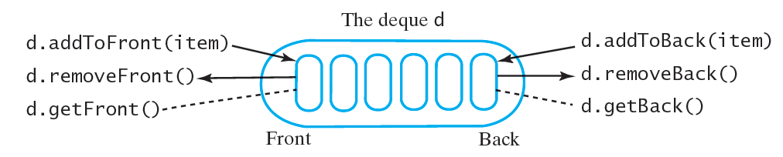
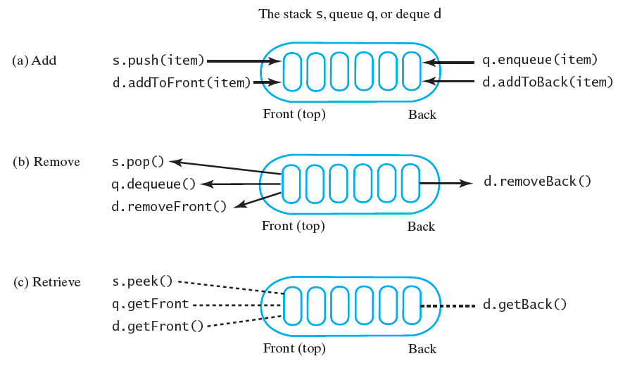

Slide 78
Methods in Deque
For insert:
public void addFirst(T newEntry)
public boolean offerFirst(T newEntry)
public void addLast(T newEntry)
public boolean offerLast(T newEntry)

Slide 79
Methods in Deque
For remove:
public T removeFirst()
public T pollFirst()
public T removeLast()
public T pollLast()

Slide 80
Methods in Deque
For Retrieve:
public T getFirst()
public T peekFirst()
public T getLast()
Public T peekLast()
public boolean isEmpty()
public void clear()
public int size()

Slide 81
Deque extends Queue
Thus inherits
add, offer, remove, poll, element, peek
Adds additional methods
push, pop

Slide 82
Class ArrayDeque
Implements Deque
Note – has methods appropriate for deque, queue, and stack
Could be used for instances of any of these
Constructors
public ArrayDeque();
public ArrayDeque(int initialCapacity);

